Slide 1
Improving N & M Imports Business Process
Team 1:
Bridgette Dibble
Christopher Harrison
Madan Thapa
Jaehun Yoo

Slide 2
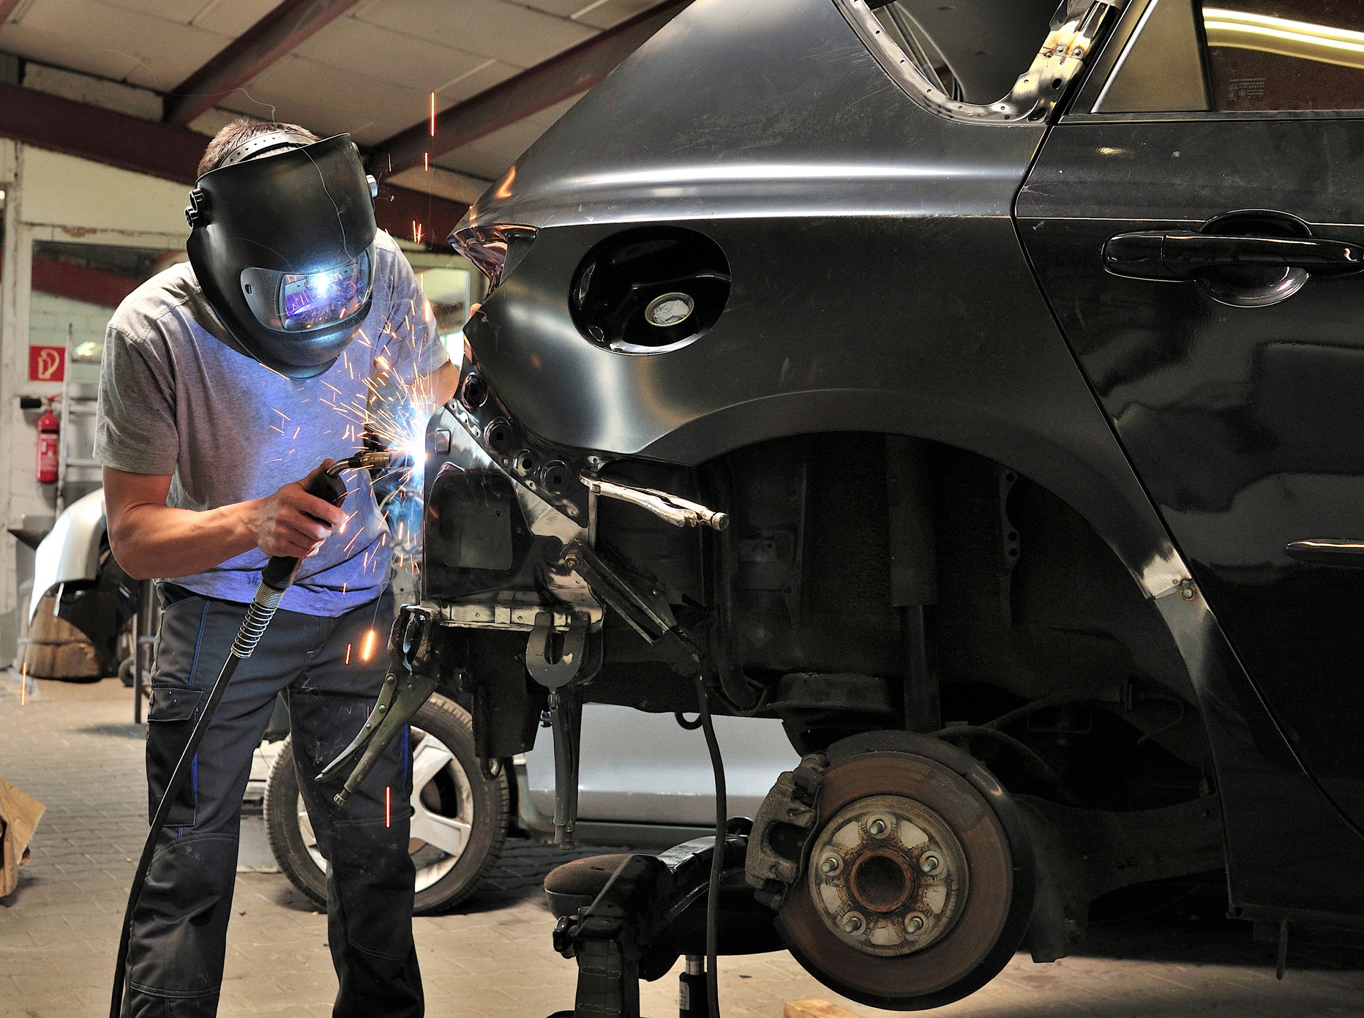
All about N & M Imports
N & M Imports is a local automobile sales and repair shop located in Baltimore, Maryland.
They have been serving the Catonsville, Ellicott City and Arbutus area for over three decades.
It is a small shop, so the owner, Nadar, and about four other employees work there full time.

Slide 3
Issues Within N & M Imports
Inefficient Processes
Appointment System
Outdated Website
Online Inventory of Vehicles

Slide 4
Data Collection
To collect data regarding issues within N & M Imports, our team administered a survey to the owner, Nadar, and the auto technicians. The survey consisted of questions such as:
What processes do you feel could be improved? Any ideas as to how?
In what ways could we potentially increase business profits?
Would you be comfortable with upgrades and increases in the amounts of technology used at N & M Imports?

Slide 5

Our Potential Solutions
Solution 1: An Online Appointment System
Scheduling system linked to the website
Automatically notifies N & M Imports of appointments made
Allows for increased efficiency and preparedness
Solution 2: An Online Marketplace on the Website
Frequently updated online inventory of vehicles available
Increase in business customers & profits
Notes:
Implementing an online scheduling system for appointments in which customers are able to choose from dates and times for appointments that are available. these scheduled appointments will then be automatically placed on N & M Imports list of appointments, allowing them to save time taking appointments over the phone and better prepare for the appointments in order to improve efficiency.

Slide 6
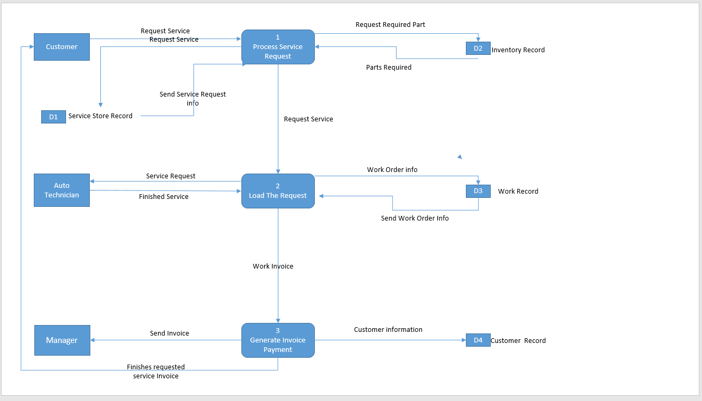
DFD of existing practice

Slide 7
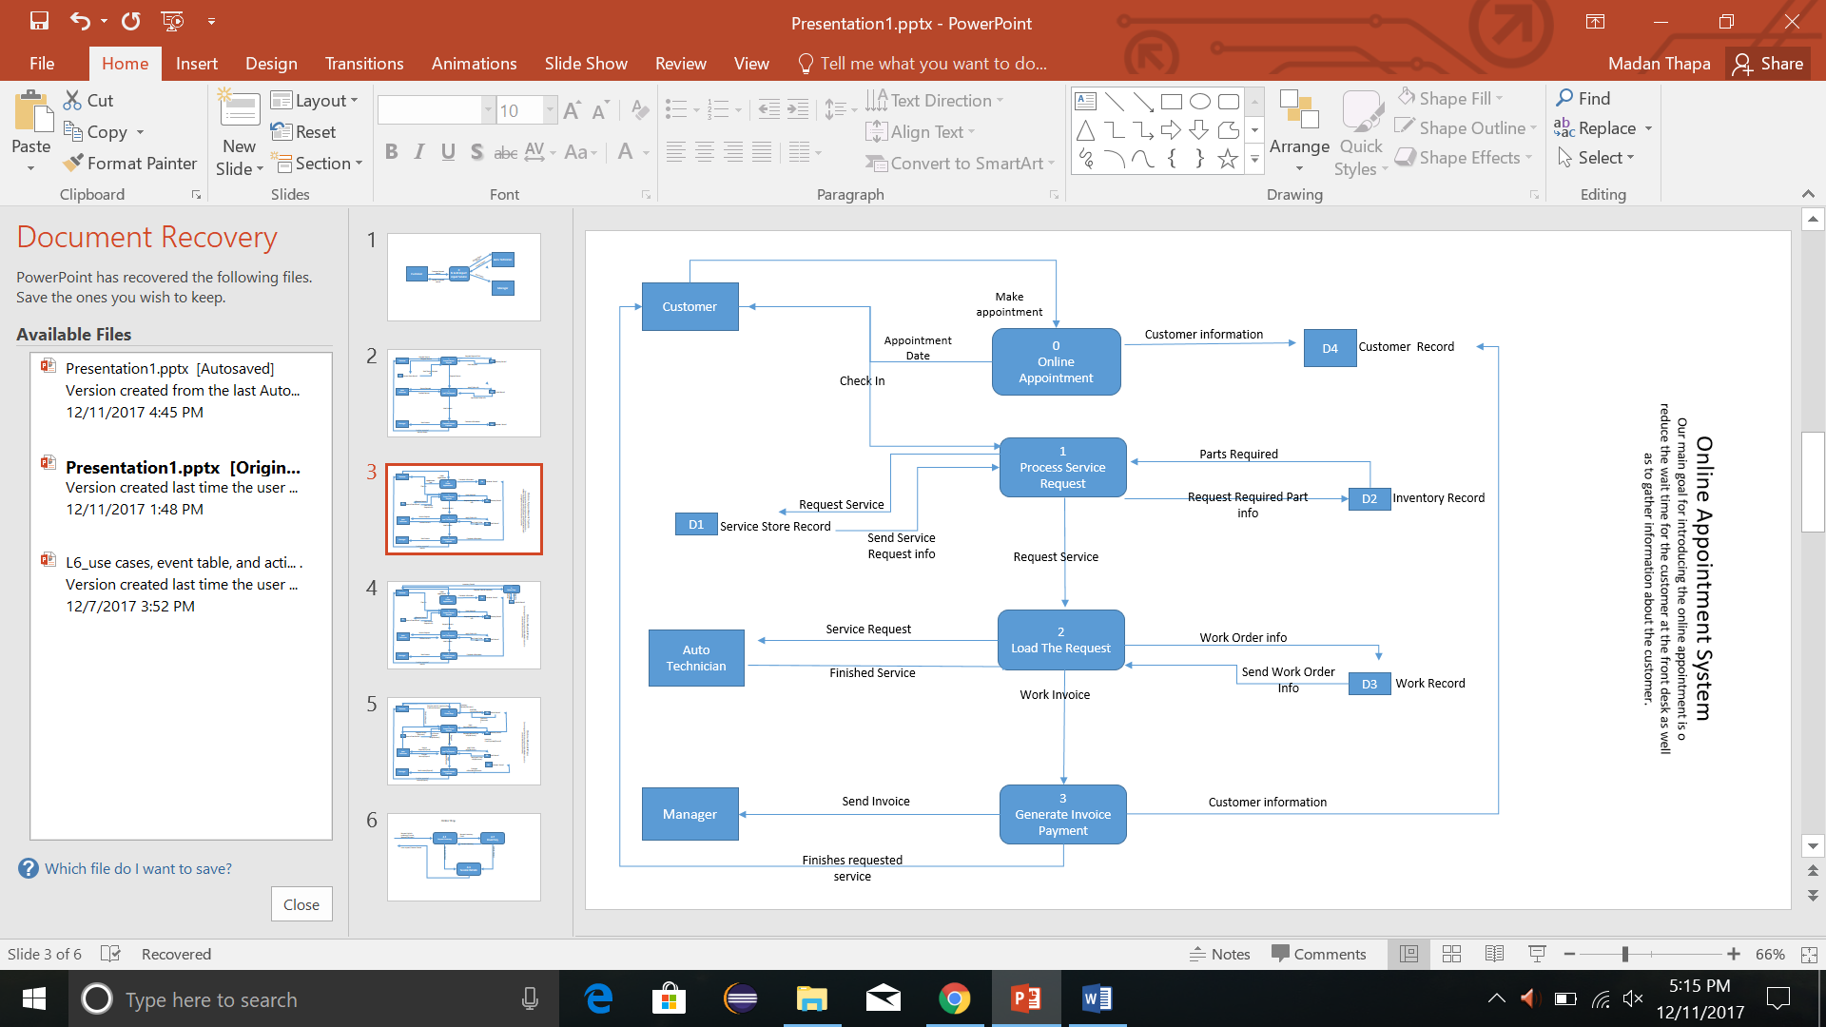
DFD of Implementation of Solution 1

Slide 8
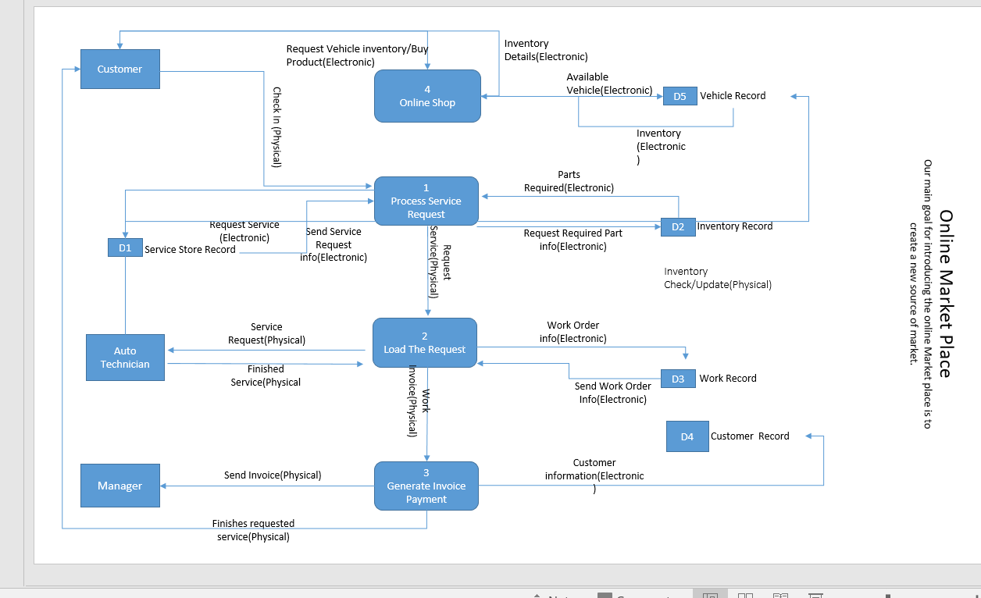
DFD of Implementation of Solution 2

Slide 9
Solution 1- Cost Benefit Analysis
One time costs - $29,000 (salary, new hardware, software, training, site preparation)
Maintaining costs - $ 1,650 (software maintenance, increase data storage, website maintenance, site promotion)
Cost benefits - $ 18,000 (cost reduction, increase speed of activity, improvement in management and control)
Overall profit in five year - $21,647
ROI - 0.94
Break even-point - 3 years

Slide 10
Solution 2- Cost Benefit Analysis
One time costs - $17,500 (salary, new hardware, software, training, site preparation)
Maintaining costs - $ 1,650 (software maintenance, increase data storage, website maintenance, site promotion)
Cost benefits - $ 15,500 (cost reduction, increase speed of activity, improvement management planning and control)
Overall profit in five year - $12,170
ROI - 1.47
Break even-point - 4 years

Slide 11
Requirement Matrix- Solution 1
Criteria | Solution 1
Usability | Is risky due to uncertainty with customer awareness / amount of actual use of the online appointment scheduling system
Online system | Required in order to execute this alternative
Frequent updates | Required to allow for continued use of the online scheduling system
Cost | Once initial creation and implementation costs are covered, there will be an additional cost of $50 per month for system maintenance
Time | The time goal is for the system be up and running at the beginning of this coming year

Slide 12
Requirement Matrix- Solution 2
Criteria | Solution 2
Usability | Is risky due to uncertainty with customer awareness and actual profits that will be generated
Online system | Required in order to execute this alternative
Frequent updates | Required to allow for continued use of the online inventory system
Cost | Once initial creation and implementation costs are covered, there will be an additional cost of $50 per month for system maintenance
Time | The time goal is for the system be up and running at the beginning of this coming year, the inventory system needs to be started right away as it will take more time to complete and implement

Slide 13
Our Recommended Solution
Solution 2
New Source of Revenue
Reduce old inventory of Vehicle
More Space for new projects

Slide 14
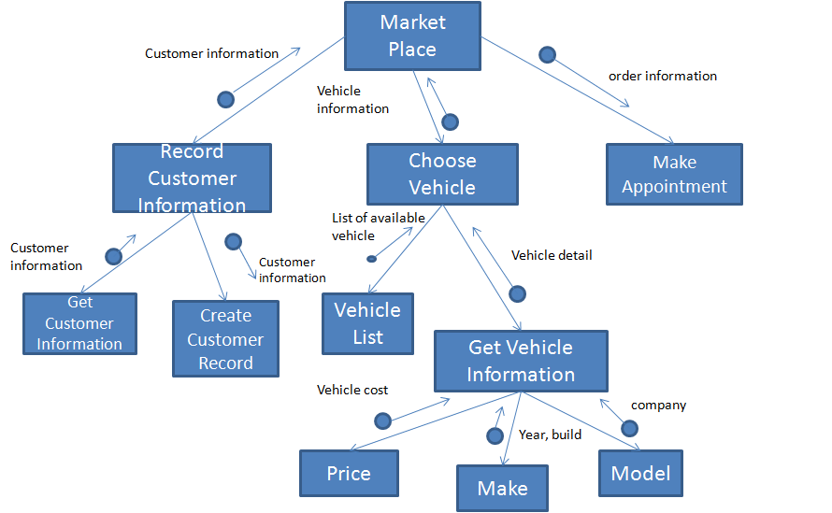
Structure Chart for Recommendation

Slide 15
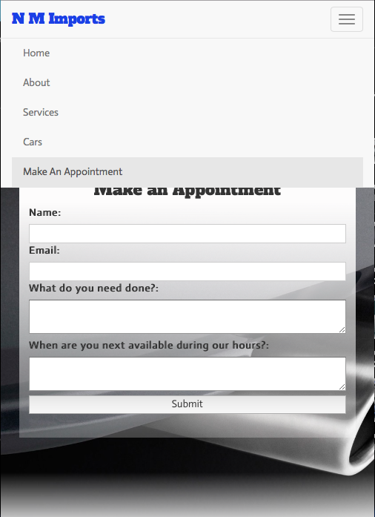
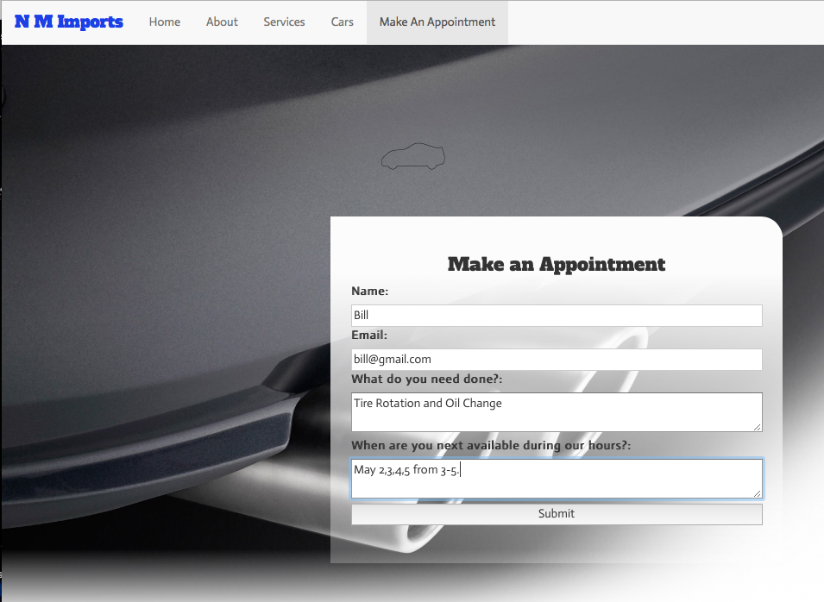
Two Inputs Demo
Why did we design it this way?

Slide 16
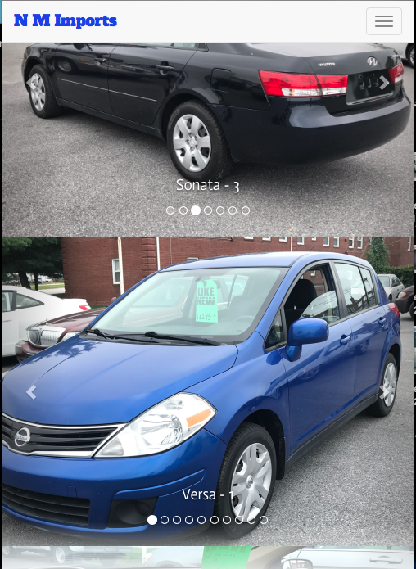
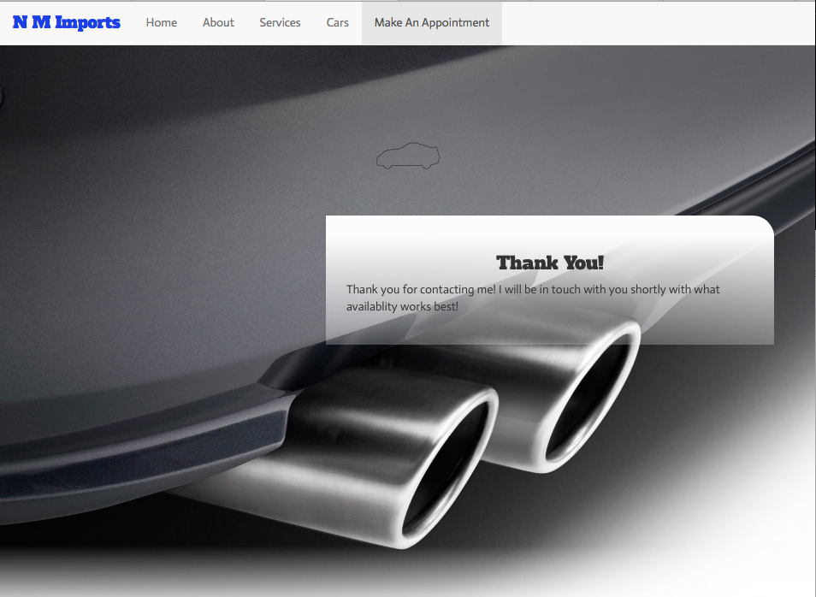
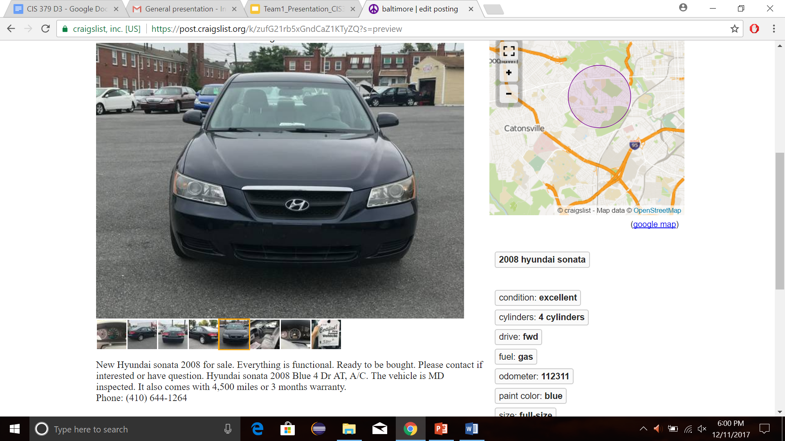
Two Outputs Demo

Slide 17
Questions?

